Slide 1
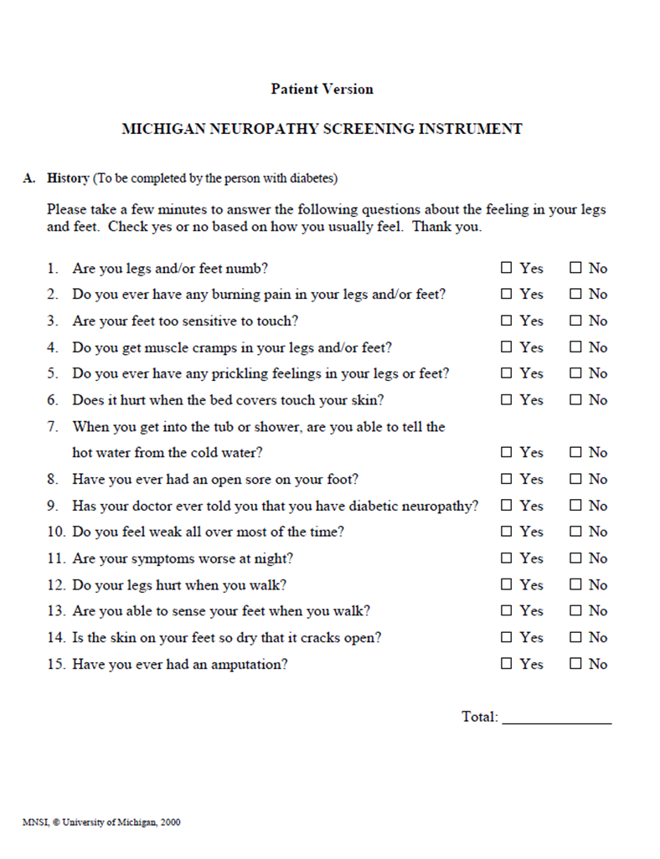
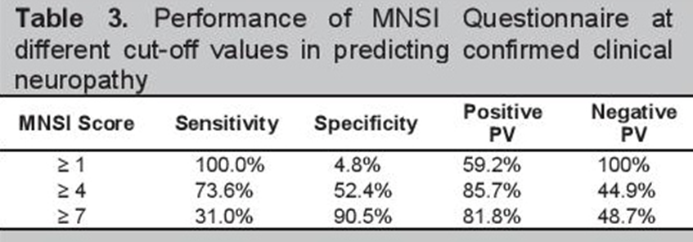
Evaluation of the relationship between Diabetic Peripheral Neuropathy and Vitamin B12 level in diabetic patients
Umut Devrim Kahraman¹, Azize Esra GÜRSOY²
¹Bezmialem Vakıf University, Faculty of Medicine, Istanbul, Turkey
²Bezmialem Vakıf University, Faculty of Medicine, Department of Neurology, Istanbul, Turkey
Introduction
Results
Diabetic peripheral neuropathy is the most common cause of adult polyneuropathy. The most common type is distal symmetrical polyneuropathy (DSPN). Paresthesia, numbness and neuropathic pain are presentation symptoms of DSPN, whereas motor weakness is a symptom in later stages. Vitamin B12 deficiency has been reported in some patients with DSPN, and there are conflicting results regarding the results of B12 replacement therapy. It is suggested in the literature that Metformin, a biguanide derivative used in the first-line treatment of Type 2 Diabetes Mellitus (T2DM), causes vitamin B12 deficiency in various studies, and therefore has an effect on the clinical picture.
A significant negative correlation was found between FBG and serum B12. We found a significant negative relationship between HbA1c and serum B12. There was a positive significant relationship between HbA1c and the MNSI scores.
Material and Method
In order for our study to be considered strong and statistically significant, the correlation between Fasting Blood Glucose (FBG), HbA1c and Vitamin B12 levels, which are planned to be checked in at least 62 patients, with the Michigan Neuropathy Screening Insturment will be examined and the p value will be calculated for significance. The Michigan Neuropathy Insturment consists of 2 parts. The first part consisted of a verbal evaluation / questionnaire with the patient and the second part was a physical examination part. At the end of the examination, a score was given in line with the answers given to the questionnaire, symptoms and findings in the examination. The survey part is evaluated over 15, and the inspection part is evaluated over 10. While the test of those who score 7 and above in the questionnaire is considered abnormal, those who score 2.5 and above in the examination are considered abnormal.
Conclusion
It can be concluded that the level of Vitamin B12 in patients using Metformin was low especially with high FBG and HbA1C levels. However, Vitamin B12 was not correlated with MNSI scores. Vitamin B12 screening should maintain its place in patients who come with high HbA1c and FBG with or without neuropathy symptoms. Because of the relationship between HbA1c and MNSI scores we suggest that, it is necessary to check the vitamin B12 level in patients presenting with neuropathic symptoms and with high HbA1c values.
References
1. Cashman CR, Höke A. Mechanisms of distal axonal degeneration in peripheral neuropathies. Neurosci Lett. 2015;596:33–50. doi:10.1016/j.neulet.2015.01.048
2. Ko SH, Ko SH, Ahn YB, Song KH, Han KD, Park YM, et al. Association of vitamin B12 deficiency and metformin use in patients with type 2 diabetes. J Korean Med Sci 2014;29:965–72.
3. Wulffelé MG, Kooy A, Lehert P, Bets D, Ogterop JC, Borger van der Burg B, et al. Effects of short-term treatment with metformin on serum concentrations of homocysteine, folate and Vitamin B12 in type 2 diabetes mellitus: A randomized, placebo-controlled trial. J Intern Med. 2003;254:455–63.
4. Staff, N., & Windebank, A. (2014, October 20). Peripheral neuropathy due to vitamin deficiency, toxins, and medications. Retrieved November 23, 2020

